Slide 1
Chapter 6
Developing an Effective Business Model
6-<number>

Slide 2
Chapter Objectives
1 of 2
Describe a business model.
Explain business model innovation.
Discuss the importance of having a clearly articulated business model.
Discuss the concept of the value chain.
Identify a business model’s two potential fatal flaws.
6-<number>

Slide 3
Chapter Objectives
2 of 2
Identify a business model’s four major components.
Explain the meaning of the term business concept blind spot.
Define the term core competency and describe its importance.
Explain the concept of supply chain management.
Explain the concept of fulfillment and support.
6-<number>

Slide 4
What is a Business Model?
Model
  A model is a plan or diagram that’s used to make or describe something.
Business Model
  A firm’s business model is its plan or diagram for how it competes, uses its resources, structures its relationships, interfaces with customers, and creates value to sustain itself on the basis of the profits it generates.
  The term “business model” is used to include all the activities that define how a firm competes in the marketplace.
6-<number>

Slide 5
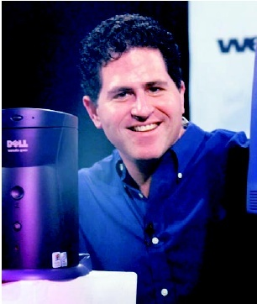
Dell’s Business Model
1 of 2
It’s important to understand that
a firm’s business model takes it
beyond its own boundaries.
Almost all firms partner with
others to make their business
models work.
In Dell’s case, it needs the
cooperation of its suppliers,
customers, and many others to
make its business model
possible.
6-<number>

Slide 6
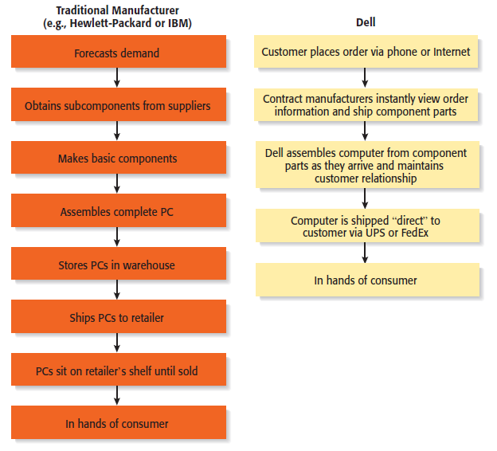
Dell’s Business Model
2 of 2
Dell’s Approach to Selling PCs versus Traditional Manufacturers
6-<number>

Slide 7
The Importance of Business Models
Having a clearly articulated business model is important because it does the following:
Serves as an ongoing extension of feasibility analysis. A business
model continually asks the question, “Does this business make
sense?”
Focuses attention on how all the elements of a business fit
together and constitute a working whole.
Describes why the network of participants needed to make a
business idea viable are willing to work together.
Articulates a company’s core logic to all stakeholders, including
all employees.
6-<number>

Slide 8
Diversity of Business Models
There is no standard business
model for an industry or for
a target market within an
industry.
However, over time, the most
successful business models
in an industry predominate.
There are always opportunities
for business model innovation.
Diversity or Variety in Business Models
6-<number>

Slide 9

Business Model Innovation
Netflix is an example of a business model innovator.
6-<number>

Slide 10
How Business Models Emerge
1 of 3
The Value Chain
  The value chain is the string of activities that moves a product from the raw material stage, through manufacturing and distribution, and ultimately to the end user.
  By studying a product’s or service’s value chain, an organization can identify ways to create additional value and assess whether it has the means to do so.
  Value chain analysis is also helpful in identifying opportunities for new businesses and in understanding how business models emerge.
6-<number>

Slide 11
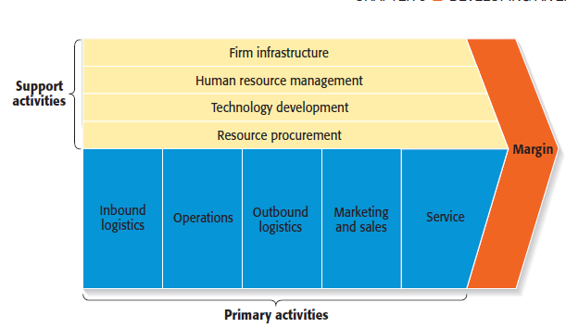
How Business Models Emerge
2 of 3
The Value Chain
6-<number>

Slide 12
How Business Models Emerge
3 of 3
The Value Chain (continued)
  Entrepreneurs look at the value chain of a product or a service to pinpoint where the value chain can be made more effective or to spot where additional “value” can be added.
  This type of analysis may focus on:
    A single primary activity such as marketing and sales.
    The interface between one stage of the value chain and another, such as the interface between operations and outgoing logistics.
    One of the support activities, such as human resource management.
6-<number>

Slide 13

Potential Fatal Flaws in Business Models
Fatal Flaws
  Two fatal flaws can render a business model untenable from the beginning:
    A complete misread of the customer.
    Utterly unsound economics.
Pets.com sported an unsound business model, and failed.
6-<number>

Slide 14
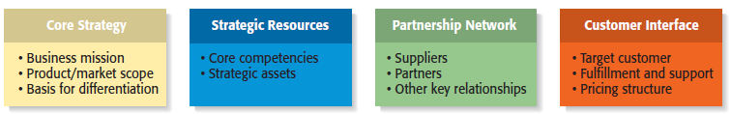
Components of a Business Model
Four Components of a Business Model
6-<number>

Slide 15
Core Strategy
1 of 3
Core Strategy
  The first component of a business model is the core strategy, which describes how a firm competes relative to its competitors.
Primary Elements of Core Strategy
  Mission statement.
  Product/market scope.
  Basis for differentiation.
6-<number>

Slide 16
Core Strategy
2 of 3
Primary Elements of Core Strategy
A firm’s mission, or mission statement, describes why it exists and what its business model is suppose to accomplish.
Mission Statement
Product/Market Scope
A company’s product/market scope defines the products and markets on which it will concentrate.
6-<number>

Slide 17
Core Strategy
3 of 3
Primary Elements of Core Strategy
It is important that a new venture differentiate itself from its competitors in some way that is important to its customers. If a new firm’s products or services aren’t different from those of its competitors, why should anyone try them?
Basis of Differentiation
6-<number>

Slide 18
Strategic Resources
1 of 3
Strategic Resources
  A firm is not able to implement a strategy without resources, so the resources a firm has affects its business model substantially.
    For a new venture, its strategic resources may initially be limited to the competencies of its founders, the opportunity they have identified, and the unique way they plan to serve their market.
  The two most important strategic resources are:
    A firm’s core competencies.
    Strategic assets.
6-<number>

Slide 19
Strategic Resources
2 of 3
Primary Elements of Strategic Resources
A core competency is a resource or capability that serves as a source of a firm’s competitive advantage. Examples include Sony’s competence in miniaturization and Dell’s competence in supply chain management.
Core Competencies
Strategic assets are anything rare and valuable that a firm owns. They include plant and equipment, location, brands, patents, customer data, a highly qualified staff, and distinctive partnerships.
Strategic Assets
6-<number>

Slide 20
Strategic Resources
3 of 3
Importance of Strategic Resources
  New ventures ultimately try to combine their core competencies and strategic assets to create a sustainable competitive advantage.
  This factor is one that investors pay close attention when evaluating a business.
  A sustainable competitive advantage is achieved by implementing a value-creating strategy that is unique and not easy to imitate.
  This type of advantage is achievable when a firm has strategic resources and the ability to use them.
6-<number>

Slide 21
Partnership Network
1 of 3
Partnership Network
  A firm’s partnership network is the third component of a business model. New ventures, in particular, typically do not have the resources to perform key roles.
  In most cases, a business does not want to do everything itself because the majority of tasks needed to build a product or deliver a service are not core to a company’s competitive advantage.
  A firm’s partnership network includes:
    Suppliers.
    Other key relationships.
6-<number>

Slide 22
Partnership Network
2 of 3
Primary Elements of Partnership Network
A supplier is a company that provides parts or services to another company. Intel is Dell’s primary suppler for computer chips, for example.
Suppliers
Firms partner with other companies to make their business models work. An entrepreneur’s ability to launch a firm that achieves a competitive advantage may hinge as much on the skills of the partners as on the skills within the firm itself.
Other Key Relationships
6-<number>

Slide 23
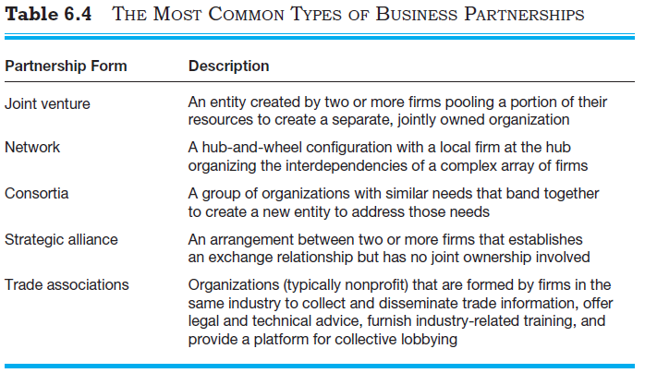
Partnership Network
3 of 3
The Most Common Types of Business Partnerships
6-<number>

Slide 24
Customer Interface
1 of 3
Customer Interface
  The way a firm interacts with its customer hinges on how it chooses to compete.
    For example, Amazon.com sells books over the Internet while Barnes & Noble sells through its traditional bookstores and online.
  The three elements of a company’s customer interface are:
    Target customer.
    Fulfillment and support.
    Pricing model.
6-<number>

Slide 25
Customer Interface
2 of 3
Primary Elements of Customer Interface
Target Market
A firm’s target market is the limited group of individuals or businesses that it goes after or tries to appeal to.
Fulfillment and support describes the way a firm’s product or service reaches it customers. It also refers to the channels a company uses and what level of customer support it provides.
Fulfillment and Support
6-<number>

Slide 26
Customer Interface
3 of 3
Primary Elements of Customer Interface
The third element of a company’s customer interface is its pricing structure. Pricing models vary, depending on a firm’s target market and its pricing philosophy.
Pricing Structure
6-<number>

Slide 27
Recap: The Importance of Business Models
Business Models
  It is very useful for a new venture to look at itself in a holistic manner and understand that it must construct an effective “business model” to be successful.
  Everyone that does business with a firm, from its customers to its partners, does so on a voluntary basis. As a result, a firm must motivate its customers and its partners to play along.
  Close attention to each of the primary elements of a firm’s business model is essential for a new venture’s success.
6-<number>

